Slide 1
EY BWW Data Challenge 2022
Level 1 : Local Frog Discovery Tool
12th June 2022

Slide 2

Sections
Section
A. | My Approach to solving the data challenge
B. | Key Elements of Approach Used
C. | Explanation of Model Used and its Results
D. | How this approach could help improving biodiversity richness

Slide 3

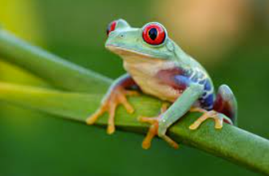
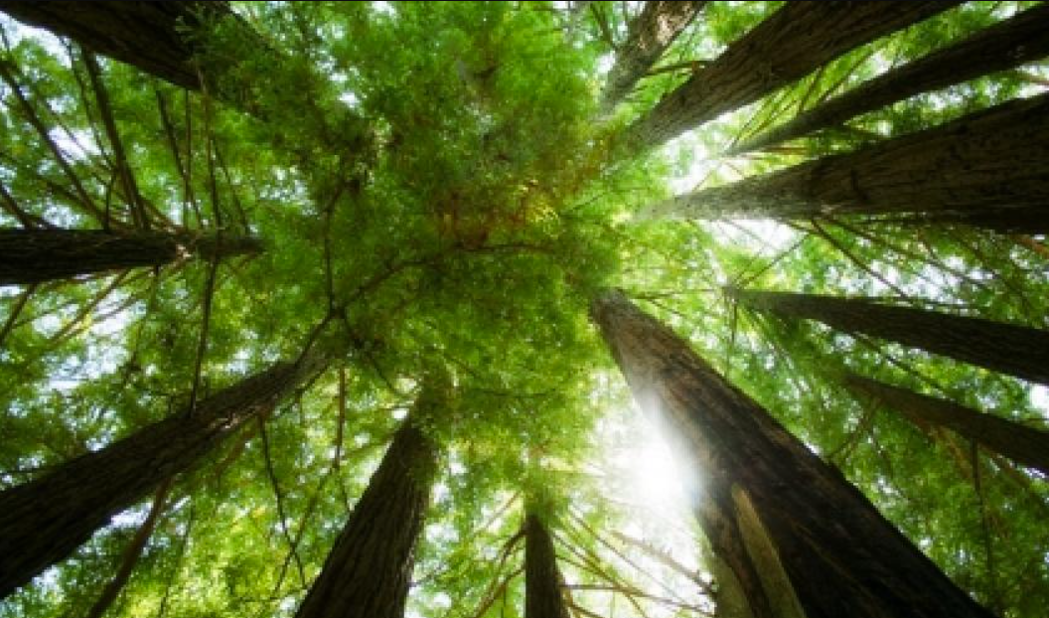
Why the Approach is the best?
Interpretable, Easy to use as there’s not much complicated calculation/ manipulation going on in data prep
The benefits of using class weight to deal with the imbalanced data:
Not losing any information in original dataset
Better than downsampling as no information will be lost
All records will be used for training, which increases the model performance
1
2
3
Using metrics like standard deviation, median, min and max definitely improved the model performance

Slide 4
Key Elements of Approach Used
“
1
Binning the Terraclimate data in 2 years interval seems to work the best for 2014-2015, 2016-2017, 2018-2019
2
Other than taking the mean of features in 2 years data, other metrics like standard deviation, median, min, max were proven to have almost the same predictive power on the target label
3
To deal with the imbalanced data, sample weighting based on class ratio is used instead of the conventional ways of upsampling / downsampling

Slide 5
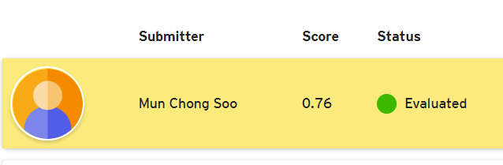
Explanation of the model used and its results
Model Used
1
XGBoost, which has become the go-to-solution for working on tabular data
2
Tuning Hyperparameters such as learning rate, number of trees, max_depth etc
F1-score :
Page 5

Slide 6
How could this approach help improving Biodiversity richness
“
1
The species distribution model (SDM) would be able to predict the distribution of frogs across different regions of Australia
2
Help identify endangered frog species in Australia
3
As indicators for the environmental health of the ecosystems in different regions in Australia as frogs are sensitive to environmental changes

